Slide 1
American Rocketry Challenge
Day 9

Slide 2
What is it?
Rocketry competition for middle and high schoolers
1000 teams, around 5000 students every year
Typically enter it through a school club
National competition at DC
Max 2 teams per school
Winner goes to international competition
Prize money!

Slide 3
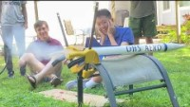
Marketing Competition

Slide 4
Presentation Competition
Modeled after international competition
Presentation on:
How you came to your design
How you conducted and utilized your test flight information
What lessons your team learned in rocketry
How teamwork played a part in your team’s success

